Slide 1
Introduction to: Scoring a Race with
Wifi: B1E30
PW: 100287336
By Eric Brinsfield
Asst. Lee Anderson
Examples in this session use fake data based on LCSA

Slide 2
Scope of this session
Starts with the assumptions that:
You have already installed the Sailwave software
Sailwave data file has already been created by you or someone else
Someone either:
Sent you the data file
You downloaded or copied it from the Dropbox site
You have the data file on your local hard drive
Sailwave data file has been initialized with all necessary setup options
All competitors have been loaded
A race has finished and you have the finish sheet with finish times

Slide 3
Sailwave
Sailwave is free race scoring software that runs on Windows
They just ask that we use their logo in our scored results. We do.
The Sailwave software uses a data file that includes the information specific to your race. That data file ends in an extension of .blw.
Don’t mix it up with the software.
Details of configuring Sailwave are covered in a different session.

Slide 4
Scope of this session
Does not cover: (these are all covered in a different session)
Installing Sailwave
Download from: https://www.sailwave.com/category/sailwave
On Windows: Usually installed to: C:\Program Files (x86)\Sailwave
Sailwave setup
Loading competitors from csv or data entry
Easy, but some details related to scoring
Posting results to the BBSA website
If we have time, I can cover this
Dropbox training

Slide 5
Locations of Data and Software
BBSA Website
Resources/Documents/LCSAResults/
_lcsa_last_race.jpg
_lcsa_series_raced_races.jpg
Other files added within a few days of the race
Dropbox
BBSA_LCSA\LSCA_SailWaveData\2021Sailwave
2021_LCSA_Series2_Race1.blw
2021_LCSA_Series2_Race2.blw
Used primarily for sharing and backing up copies of the Sailwave data file
Your laptop or PC
Sailwave Software: C:\Program Files (x86)\Sailwave
Sailwave Data: C:\SailWaveDataLocal
2021_LCSA_Series2_Race1.blw
2021_LCSA_Series2_Race2.blw
_lcsa_last_race.jpg
_lcsa_series_raced_races.jpg

Slide 6
Scoring a race in an existing Sailwave file
Overview of steps
Make copy of Sailwave file with new name
Get a copy or photo of finish time sheet from race committee
Update the race parameters: race name, race distance, start time
Enter finish times using the “Sail Num Wizard”.
Score results
Create “publishable” results with Publish button.
Save screen image of results as jpg file on your local drive.
Close and save the Sailwave file and save finish sheet image

Slide 7
1. Create a copy of Sailwave file
Historical Sailwave files are stored in Dropbox folder: BBSA_LCSA\LSCA_SailwaveData
Only authorized support members have access to this folder
Usually the LCSA Coordinator, the BBSA webmaster, and designated scorers
If the file was emailed to you: Save it to your local drive
If you only using Dropbox via the web:
Download the latest Sailwave file to your local hard drive (on your PC)
If you are using the Dropbox app: Copy the file to a local folder
Rename the file with the pattern:
2022_LCSA_seriesname_racename.blw
For example: 2022_LCSA_Series1_Race2.blw

Slide 8
Why make the copy?
Sailwave files cumulatively store the race results, so the new race does not impact the old race.
But sometimes,
We need to go back and correct or start over. Re-copying is often easiest
If you accidentally edit an old race, you have a back-up for restore.
It provides a good audit trail
Disadvantage of incremental copies:
If you find a mistake for all races, you might want to go back and correct each copy. Not really necessary.
At the end of the year, we delete all of the old versions

Slide 9
2. Save image of finish sheet
The race coordinator or the RC skipper will send you an image of the race finish times.
See example to the right
You can either score from:
Your mobile device
Your PC image
A printed copy (easiest, but not always available)

Slide 10
3. Update race parameters
Open Sailwave and load the new Sailwave file
Assuming the files has already been configured for the Series
Right click on the column header of the new race. Select: Edit Race
Edit the name of the race and enter the date of the race
Keep the name short because it is displayed in the results column.
Suggest something like “S3 Race 2”
Edit each Start (fleet) by double click or select and press Edit
Edit the race distance and verify the start time for the race. These are written on the finish sheets provided by the race committee.
Edit all starts. In 2022, LCSA will have three.
Click OK when finished.

Slide 11
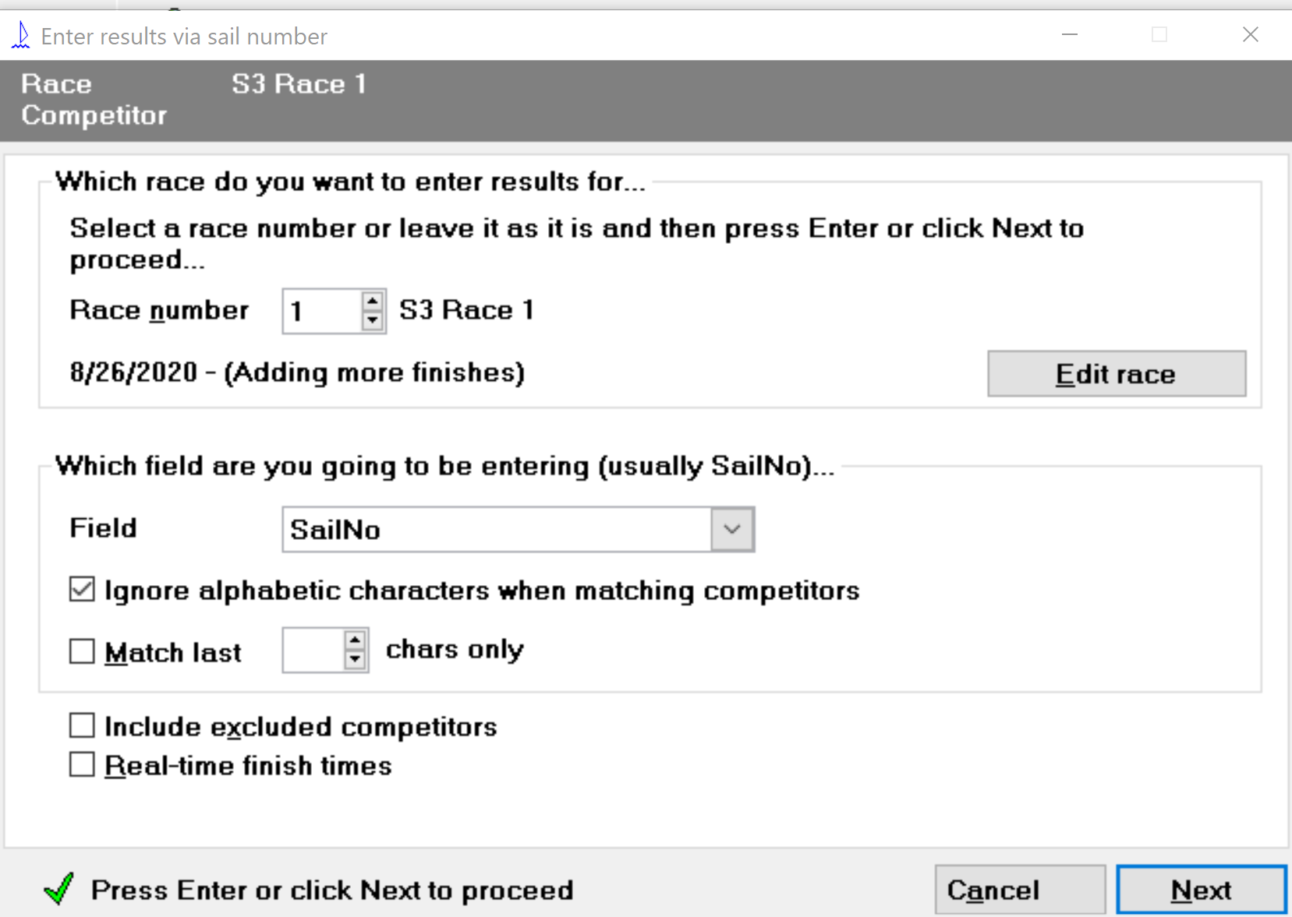
4. Score the race using Sail Num Wizard
In the fourth menu ribbon at the top of Sailwave, click on:
Set the correct race number →
Select Field: →
Boat to score by boat name
SailNo to score by sail number

Slide 12
4a. Sail num wizard: Enter code for RC boat
Press next to score each boat.
Start with race committee boat, so you don’t forget
You can search for RC by boat name or by sail number
For RC,
Instead of entering a finish time
Use the pull-down menu to select OOD
This identifies the race committee boat for proper scoring
Note: You can score RC boat at any time and even add it later, but it is good to do it first, so you don’t forget.

Slide 13
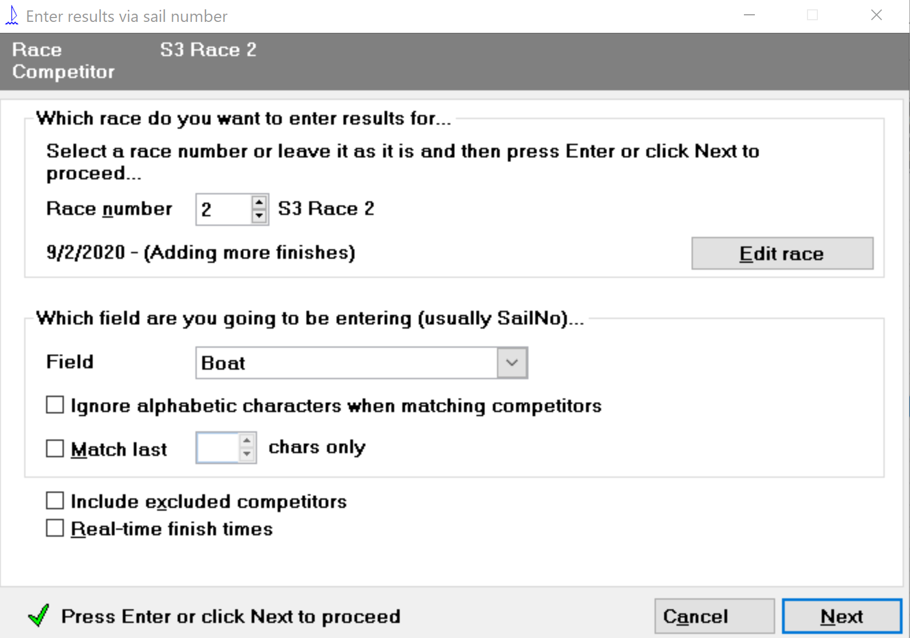
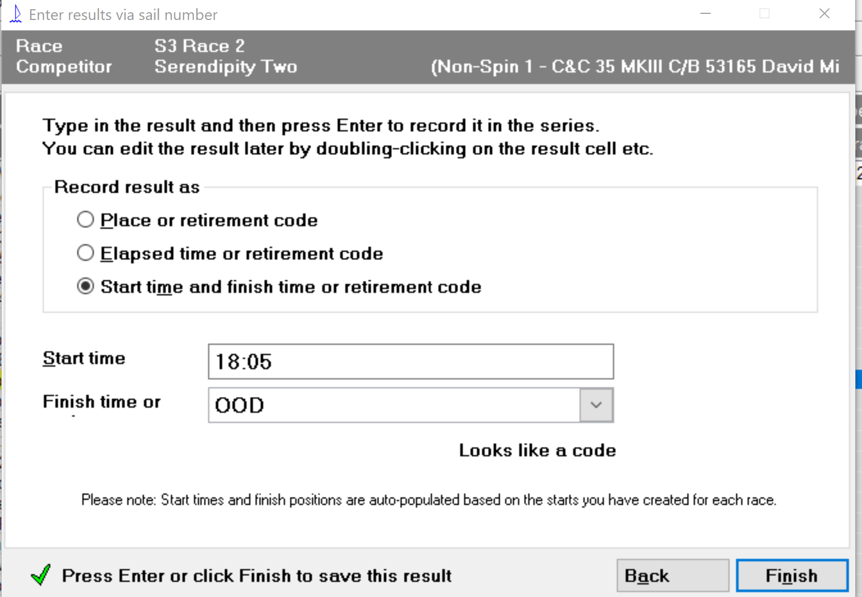
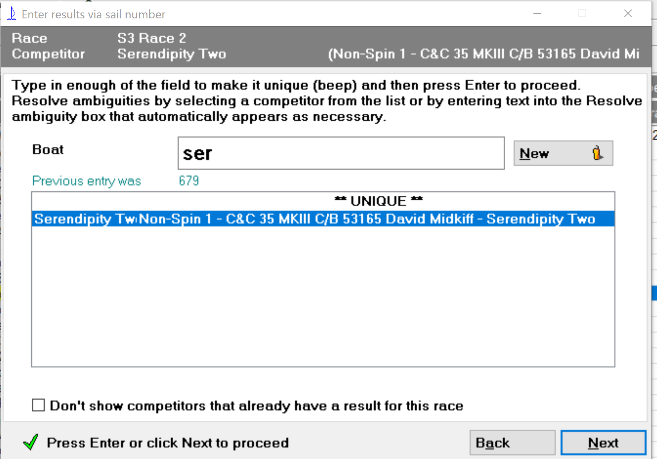
Press Finish to save entry and return to selection window for the next boat.

Slide 14
4b. Sail num wizard: Enter finish times
Set Field value based on the Finish Sheet:
If times are listed by sail number, change Field to SailNo.
If times are listed by boat name, change Field to Boat
Press Next, to search for the next boat by sail number or boat name
Select the desired boat from the list
Note that Sailwave automatically displays a list as you type the name
Select when you see the correct boat
Press enter or Next
On the next page, enter the time and press Next or Enter
Repeat until all boats are entered

Slide 15
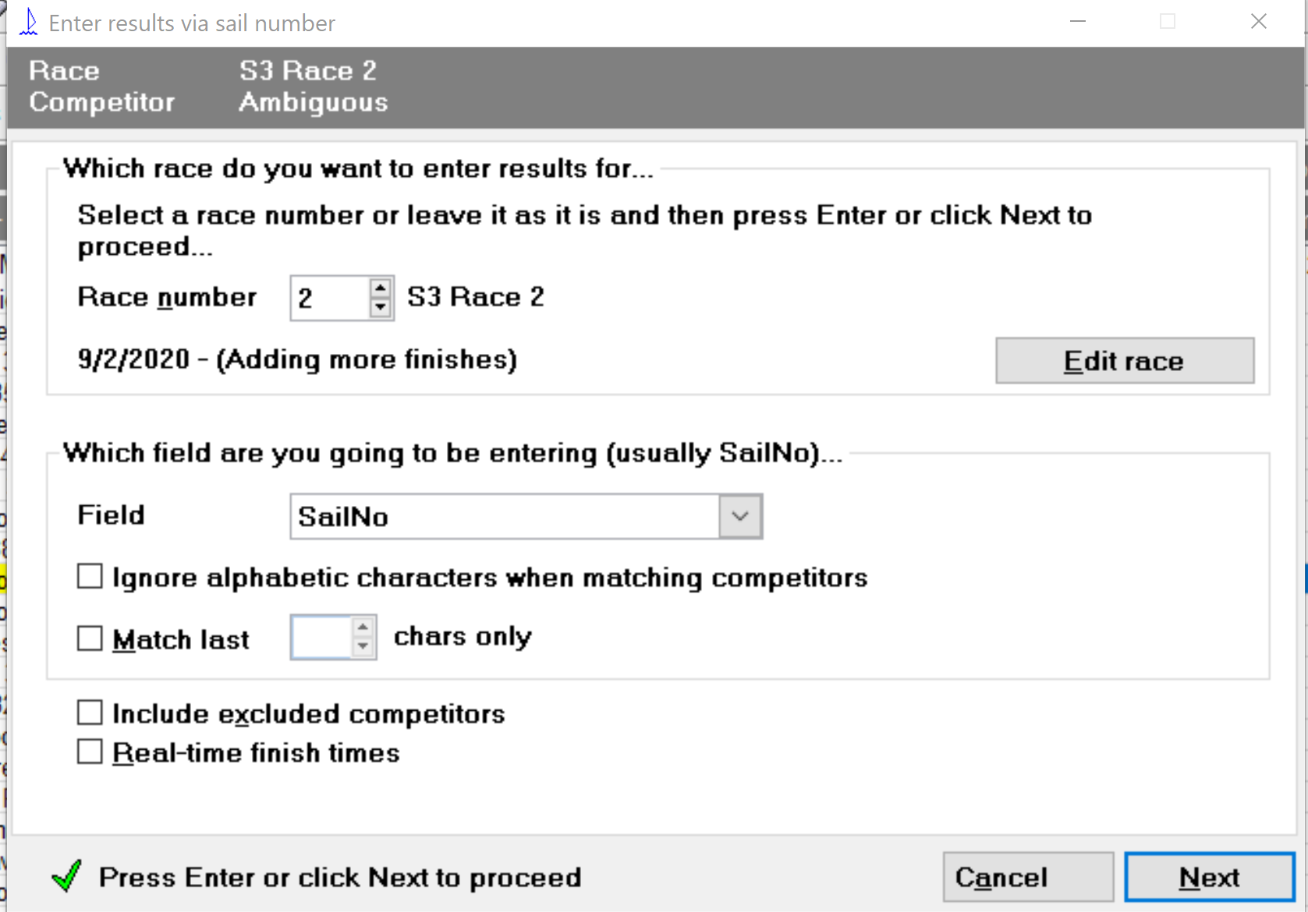
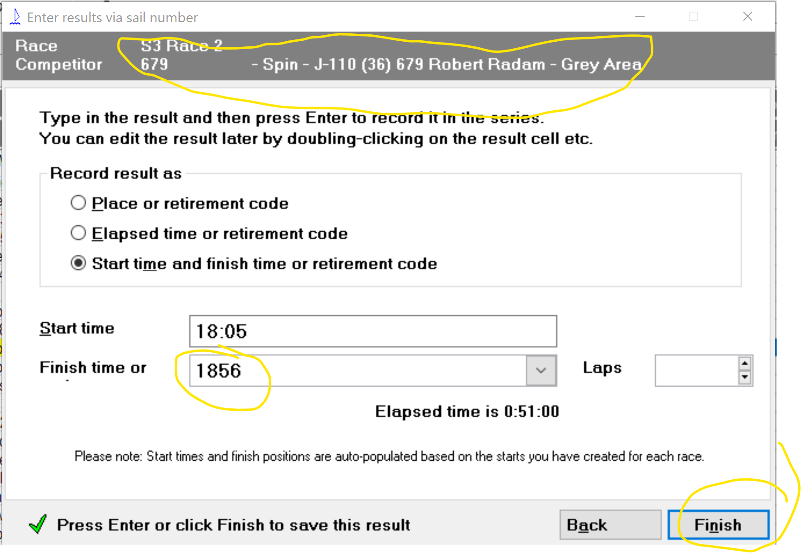
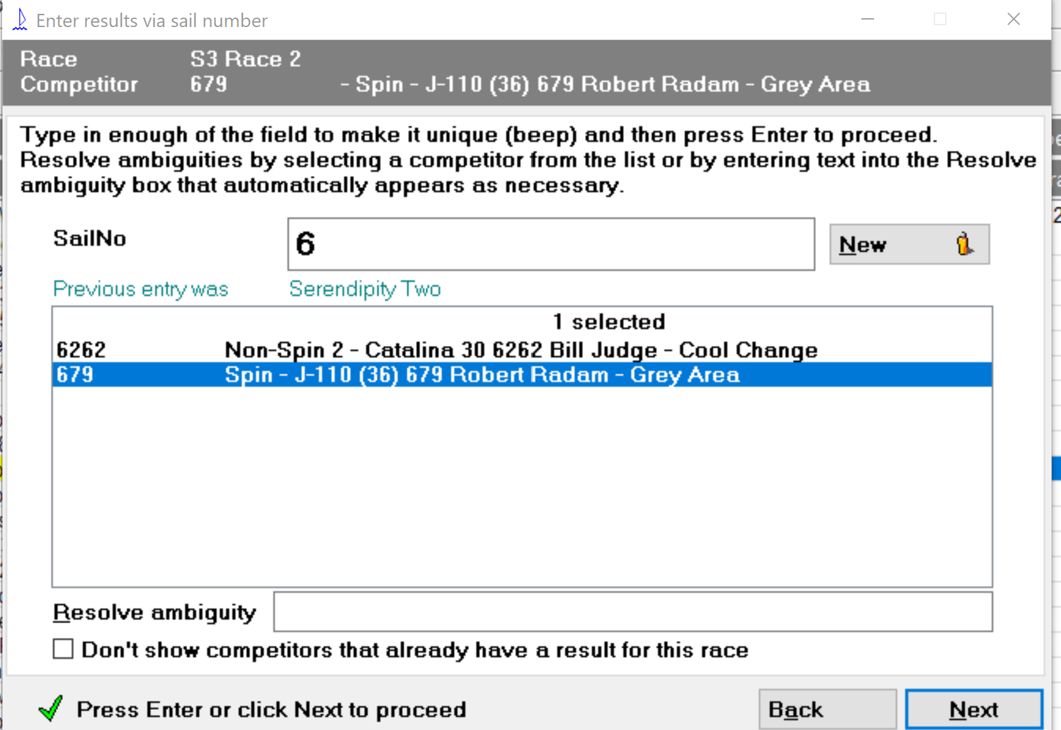
NOTE: The current boat is identified at the top of the page.
Enter finish time as military time (with or without colon)
Press enter to select the Next Boat
When all boats are entered, just close the window (x out)

Slide 16
5. Score results
After entering all finish times and the RC code, close the “Sail num wizard”
Press “Score series” at the top of the page next to “Sail num wizard”
Assuming proper initial setup for scoring, the scoring is immediate.
Results will display in the table, but not all the detail you want.
You will just see positions, but not the various times, etc.
To see all the detail, you should go to the Publish step.
Please don’t rearrange the table or columns shown in the table.

Slide 17
6. Create “publishable” results – result options
Click on Publish in the top menu ribbon
Select the Results… option from the pull-down menu
In the options page, select :
“Publish individual race tables”
Select which race. Use “Just these races” and enter one number
Review the title and adjust as you see fit.
The rest of the options and tabs should be fine
Repeat for “Publish a series summary table”
For Series, we usually use “All sailed races”

Slide 18
6. Create “publishable” results – destination options
Using the Publish feature, selected from the top menu ribbon
We want to:
Review the results to validate data entry and review results
View using Destination: “My default internet browser”
If you see errors, just edit data as needed, rescore, and re-publish
Create an image file for automatic display on the website
When results are good, resize screen and take screenshot of the display in your browser
Save to folder as:
_lcsa_last_race.jpg (for single race),
_lcsa_series_raced_races.jpg (for series)
If you already have one by that name in Dropbox, overwrite it.
At this point, you can stop and upload this image to the website (steps covered separately)
Create HTML files for re-display in the future (could defer this step to next day)
Re-publish with same options, but change Destination to: A file on my computer network
Use the Browse button so save the file to Dropbox with name: 2021_LCSA_Series3_Race2.htm
Re-publish the series results with Destination to: A file on my computer network
Save to a name, such as: 2021_LCSA_Series3_All.htm

Slide 19
7. Save Sailwave file
When you are done scoring and publishing, save the Sailwave file
You can do this as often as you like during the process of scoring
Save to the Dropbox folder:
BBSA_LSCA\LCSA_SailWaveData\yyyySailwave, where yyyy = the year
Notes:
The Sailwave file is never stored on the website file system, because it does not accept the .blw extension. We use Dropbox for the central data share.
At this point, nothing has been transferred to the website. That step is covered in a different training session.

Slide 20
2. Save image of finish sheet
The race coordinator or the RC skipper will send you an image of the race finish times.
See example to the right
Save to the Dropbox SailWaveData folder with name: 2022_LCSA_Seriesx_Racex_boatname
Where 2022=year,
Seriesx_Racex such as Series3_Race2
boatname is the RC boat
Filetype is .jpg, .png, or .pdf
Please rotate or improve the image if possible.
Optionally print for use during scoring

Slide 21
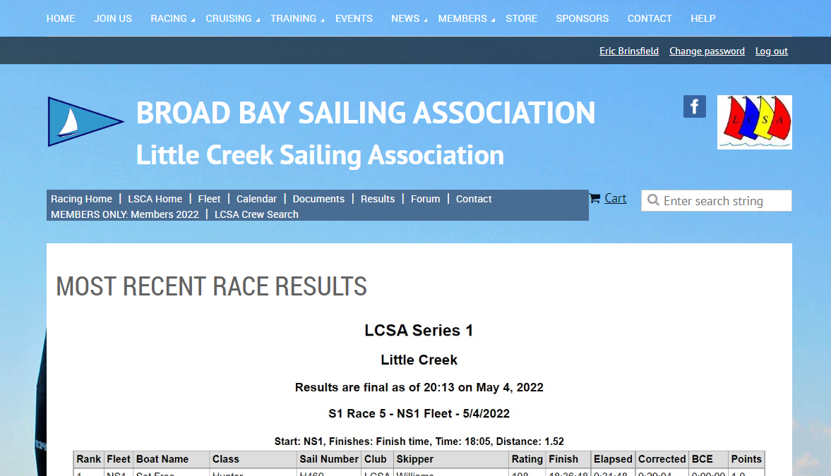
Publishing Results on Website
Available to designated web page editors

Slide 22
Summary of Publishing to BBSA Website
Log into the BBSA website with your userid
Enter Admin view
Click on “Website” in the left menu list
Click on Files in the top menu bar
Navigate to: Documents/LCSAResults
Delete _lcsa_last_race.jpg and _lcsa_series_raced_races.jpg
Click Browse to select and upload the new versions from your hard drive. (Note: Overwrite does not seem to work, so delete first)
Demo

Slide 23
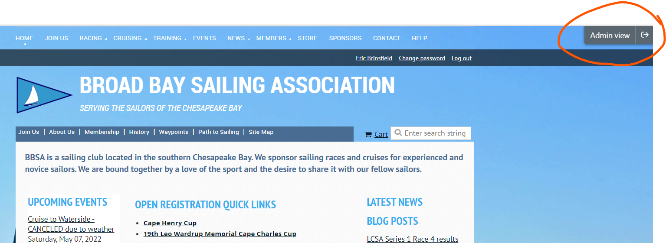
Go into Admin view (after logging in)
Warning: If you share a link from the website, make sure you are in Public view before you copy the link. Stay in Public view unless you are updating a page.

Slide 24
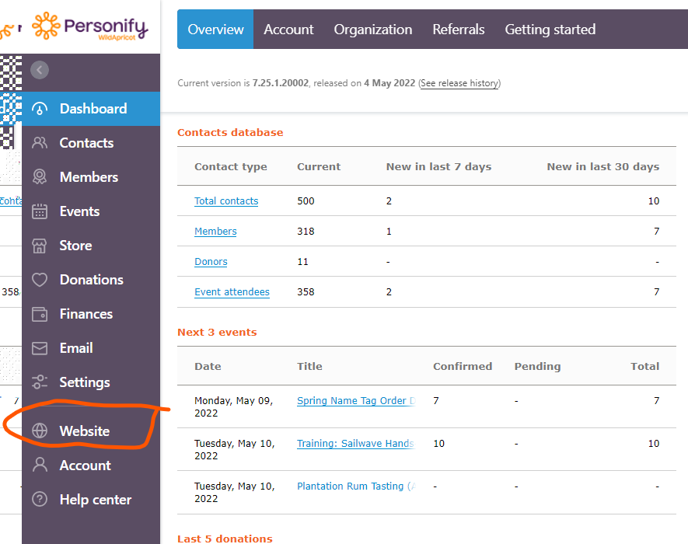
Go to the Websites view This may be all you see anyway.

Slide 25
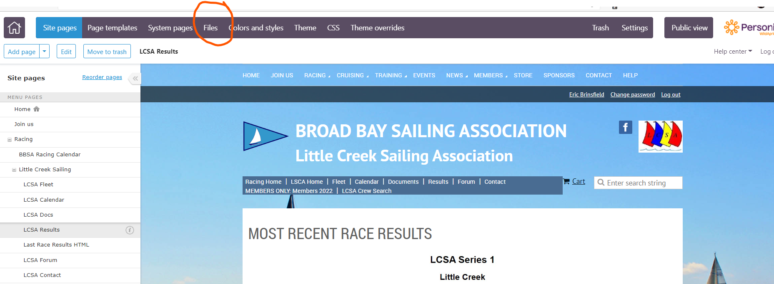
Open the Files view

Slide 26
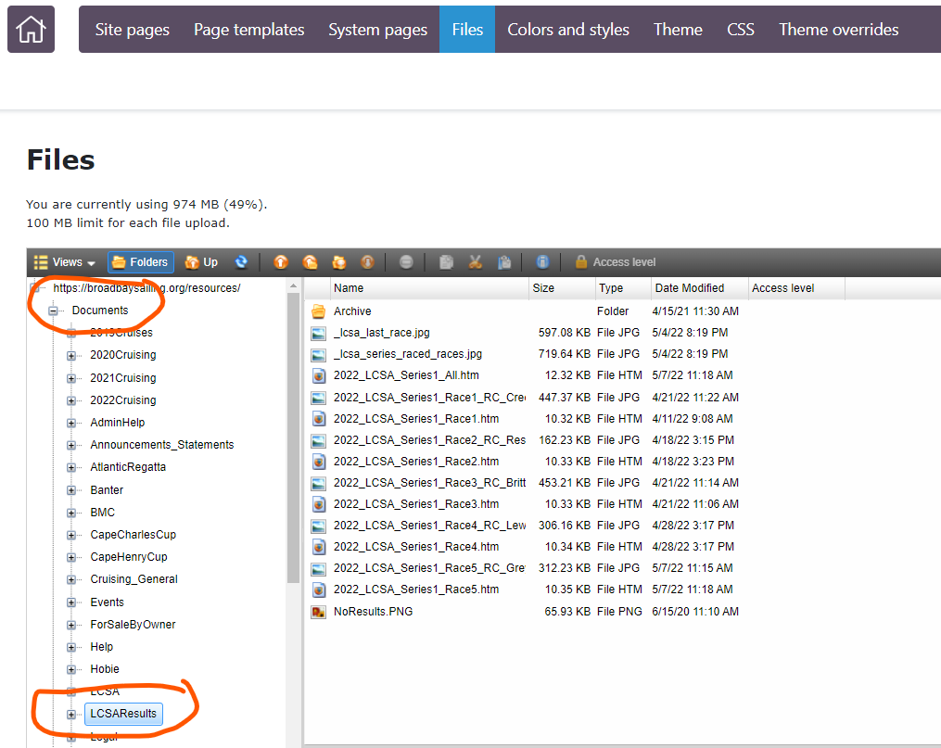
Navigate to Documents\ LCSAResults

Slide 27
Delete the old result jpgs
Highlight the files and press Delete or right-click Delete
Always delete prior to upload. The overwrite feature does not load or refresh properly

Slide 28
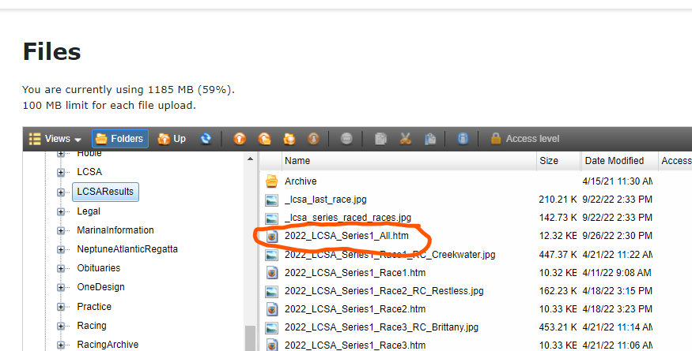
Delete the old series results for current series
We need to replace the series summary each week during the series until the series is completed
Highlight the file and press Delete or right-click Delete
Always delete prior to upload. The overwrite feature does not load or refresh properly

Slide 29
Upload the files for the current race after deleting per prior step
On Wednesday night, upload result image files:
_lcsa_last_race.jpg
_lcsa_series_raced_races.jpg
On Wednesday night or within a few days, upload:
2022_LCSA_Seriess_Racer.htm
2022_LCSA_Seriess_All.htm
2022_LCSA_Seriess_Racer_RC_boatname.fff
where s=series number, r=race number and
boatname.fff = committee boat name and filetype (pdf, jpg, or png)

Slide 30
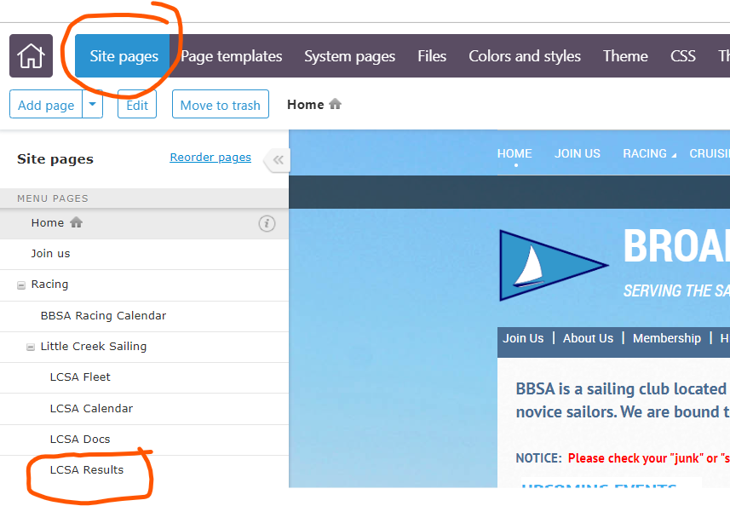
Return to the Sites section and select Results

Slide 31
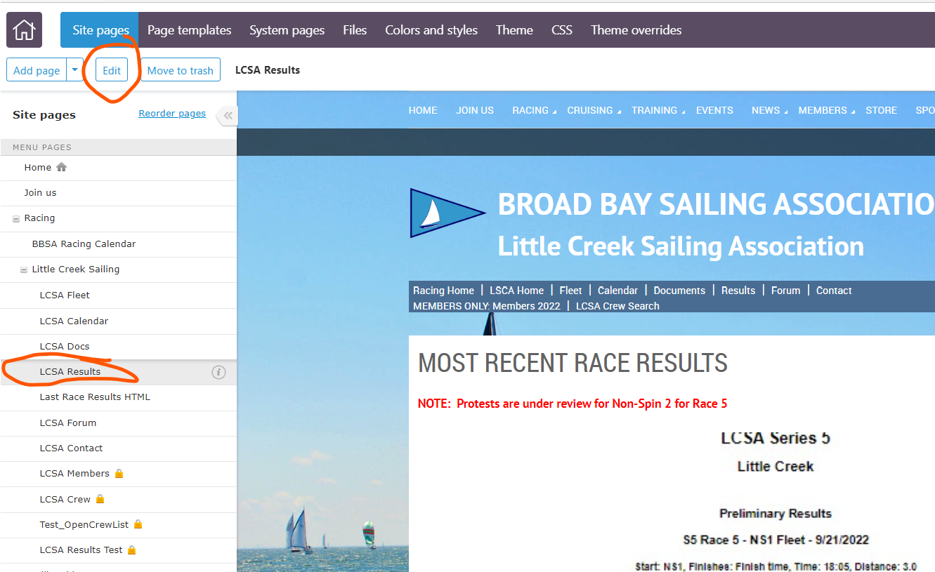
Click on Edit to edit the Results page
Scroll down to the historical section (second page where you will edit the links)

Slide 32
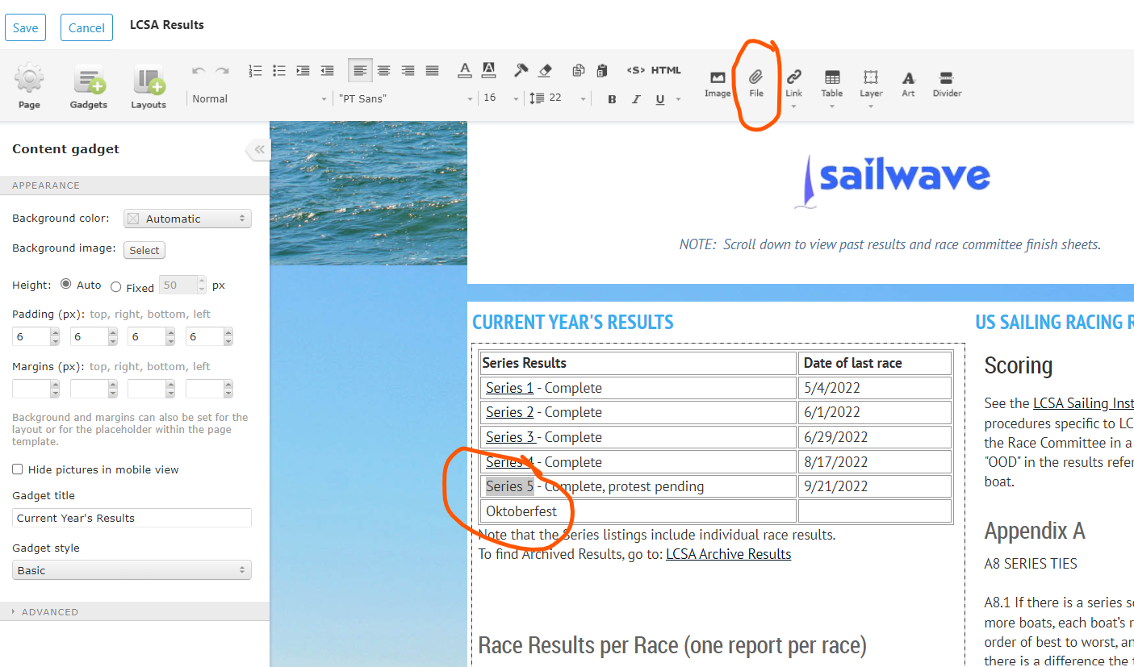
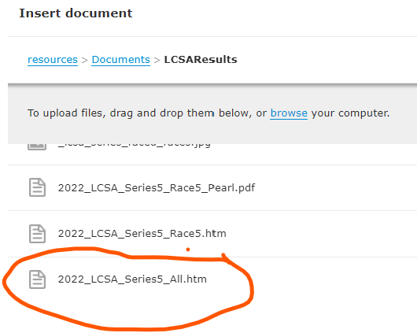
Add link to Series report
Highlight text “Series 5” then press the File action in the menu bar at the top. The file selection window will open:
Select the file and press Insert to embed a link to the file.
Press Save or edit the next link.

Slide 33
Add links for current race and finish sheet
Follow the same process to link individual races to the .htm files and the RC finish sheets to the uploaded finish images.
When done editing, press Save at the top of the page.

